Slide 1



Keeping Architectures Relevant
Using Domain-Driven Design and
Emergent Architecture
Brandon Satrom
Paul Rayner
AGILITY. CRAFT. ARCHITECTURE.
Notes:
Paul, Click Record

Slide 2


Challenges
Irrelevant Architectures
Creeping Complexity
Enterprise
Architecture
Perspective
Software
Architecture
Perspective
Notes:
The challenges we faced in our roles.
Brandon
The “user experience” of enterprise architecture
How enterprise architecture fits in an agile environment
Paul
Understanding how to connect the software architecture with business capabilities and strategy.
How to cope with business domain complexity and appropriate architectures
What should be my relationship with development teams?
Dealing with complexity and change

Slide 3


DDD & Emergent Architecture
Notes:
Paul
DDD & EA “in the trenches” of coding and architecture - three years experience in rewriting enterprise system, using DDD, emergent architecture and agile development.
We both came from different perspectives and ended up in the same place. Want to share our thoughts on some of what we have learnt
Mention Architecture Journal article coming out next month for more details

Slide 4

Domain-Driven Design (DDD) is a pattern language for strategic design and architecture.*
* not an architecture framework
Notes:
Paul …and not an enterprise data model. Example from conversation with Doug

Slide 5
A Virtuous Cycle
Relevant Modeling
Emergent Architecture
Ubiquitous Language
Notes:
Paul

Slide 6
Ubiquitous Language
Relevant Modeling
Emergent Architecture
Ubiquitous Language
Notes:
Brandon

Slide 7
Communication vs Jargon
Translate
Refine
Agree
Notes:
Brandon
Translation results in confusion that propagates into the software
Every misunderstanding is a bug in the system
Who is this translator most of the time? The architect

Slide 8
A New Shared Language
Notes:
Brandon
Typically, we feel like we have to pick one vocabulary over the other. But each have their problems:
Biz-dominated domain is relevant, but inaccurate
Tech-dominated domain is accurate and precise, but mostly irrelevant
We gain benefit by favoring both and creating a NEW language that takes elements of both and brings in new ideas

Slide 9
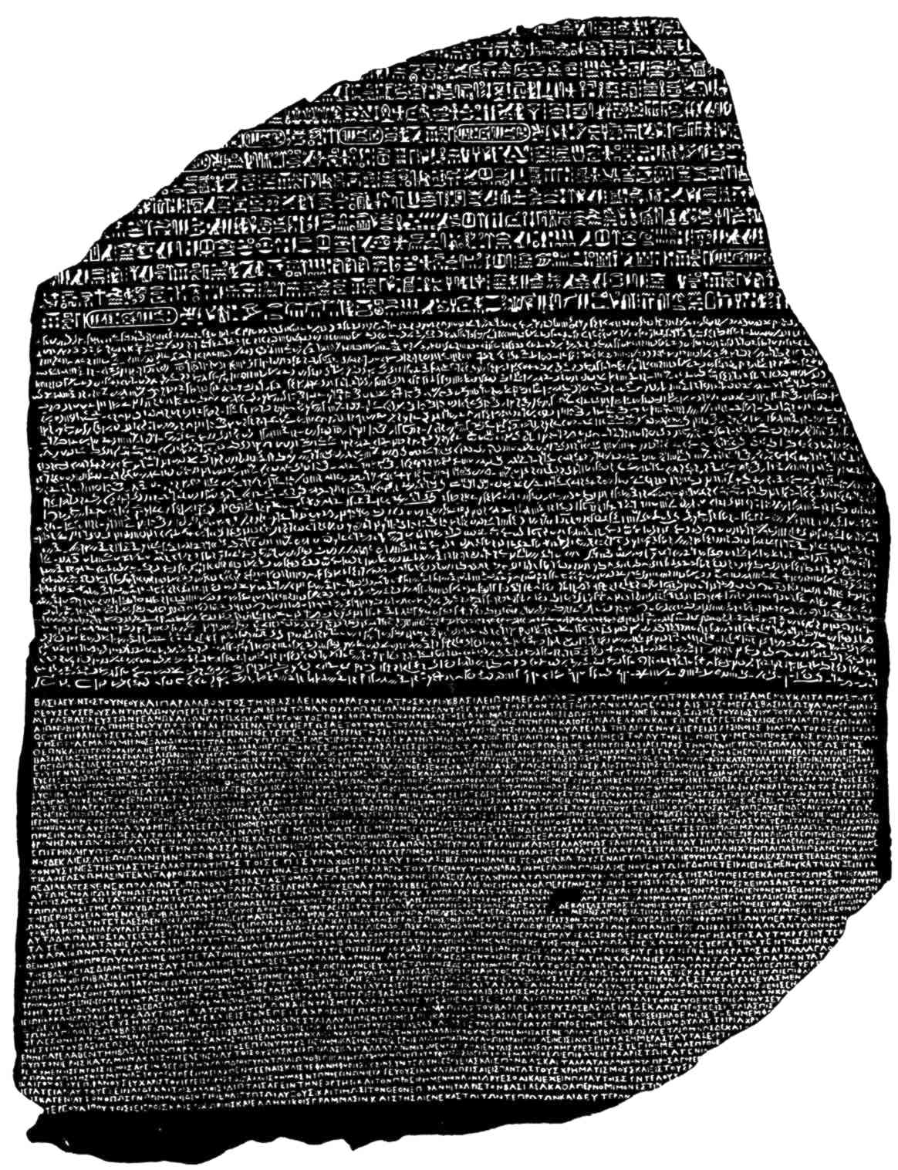
Don’t Translate, Advocate
Notes:
Brandon
Creating a new, ubiquitous takes a time commitment and leadership. An architect, typically the translator, is a perfect candidate for stepping into being an advocate for a ubiquitous language.
A new language is great, and speaking that language creates understanding? But how to we document that understanding?

Slide 10
Relevant Modeling
Relevant Modeling
Emergent Architecture
Ubiquitous Language
Notes:
Paul

Slide 11
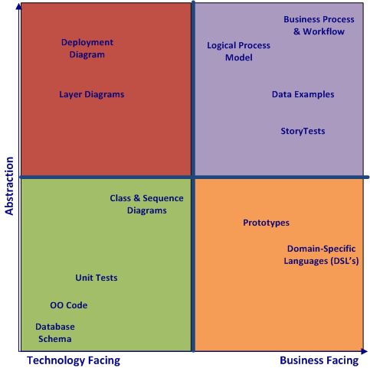
Design Artifacts
Notes:
Paul – When the requirements already written before code, then the language used in the documents already set, harder to collaborate on UL

Slide 12
“
Final source code is the real software design
— Jack Reeves
”
Notes:
Paul

Slide 13
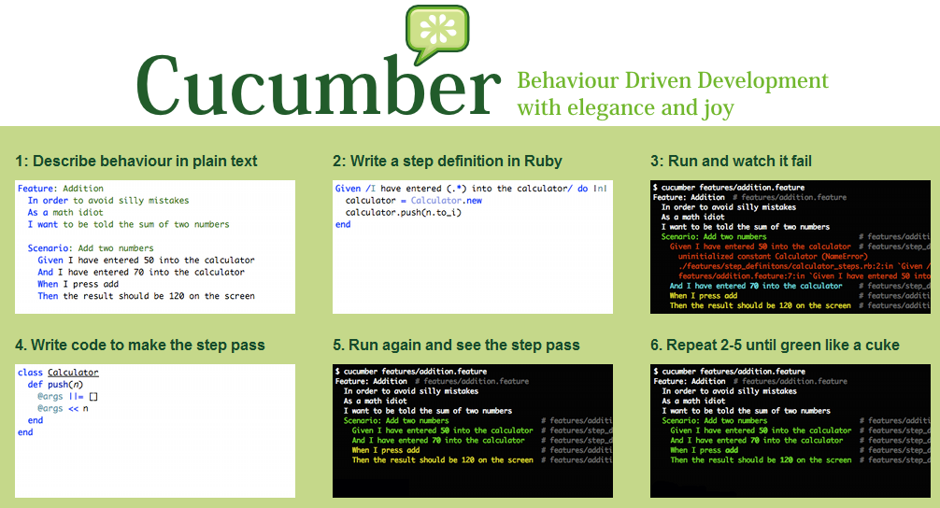
Storytesting
Notes:
Paul

Slide 14
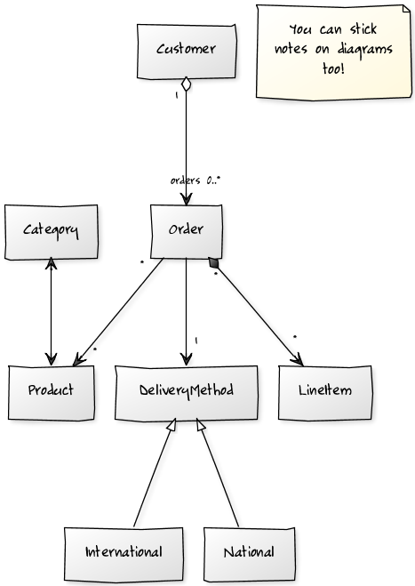
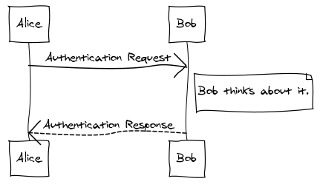
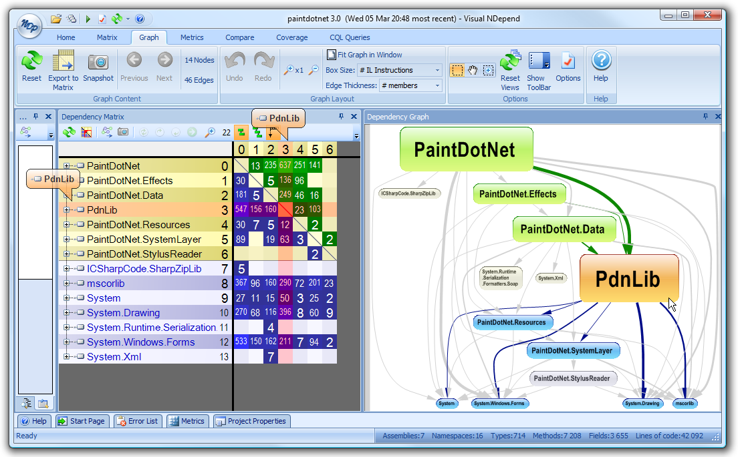
Abstractions
Notes:
Paul
Use Cucumber for storytesting system behavior. This enables users, customers and business analysts to collaborate with concrete examples and real data as the code is written. Also, UML can be combined with code analysis to increase our shared understanding of the invisible system structure.

Slide 15
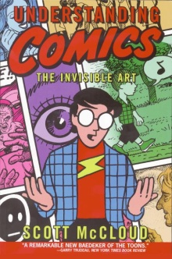
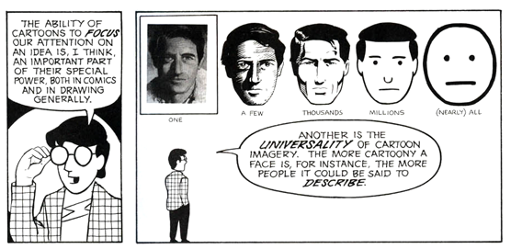
Amplification through Simplification
Notes:
Brandon
-- Remove the cruft
The more “cartoony” a domain model is, the more relevant it can be.

Slide 16
Emergent Architecture
Relevant Modeling
Emergent Architecture
Ubiquitous Language
Notes:
Brandon

Slide 17


Encapsulate
Don’t Coddle
Notes:
Brandon
Domain vision statement document.
Modeling is not a replacement for a conversation. It is, much like the agile definition of a user story, a placeholder for a conversation or evidence of a conversation and decision already reached.

Slide 18
Developers don’t own the code they create…
… so do architects own the designs they craft?
Notes:
Brandon
This is called collective code ownership… Practice in Extreme Programming

Slide 19
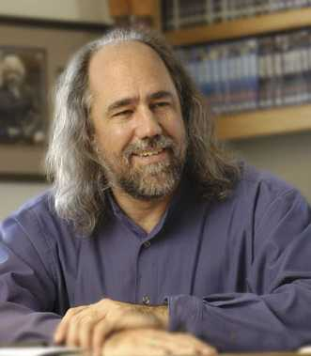
Architecture is a Shared Hallucination
Notes:
Brandon
“mutually agreed-upon design-decisions that shape a software-intensive system” Grady Booch

Slide 20

Distillation
Ol’ Core Domain
Whiskey
Notes:
Paul. Refinement
Distill as deeper insights into the domain become apparent
Architect help articulate the value of core domain distillation to stakeholders
Bounded contexts
A single, "Enterprise" Model is a bad idea
Bounded contexts and a context map
Needs to be flexible & change-absorbent without being too prescriptive

Slide 21


Anemic Domain Models
Domain Complexity
Notes:
Paul
As the complexity of the business domain increases, we should adopt a rich domain model approach, rather than the anemic domain models typically provided by ActiveRecord. Frameworks such as Ruby on Rails and S#arp Architecture for .NET help us tame some of the complexity.
Domain-Driven Design applies whenever
we are operating in a complex, intricate domain. Make the software a reflection of the domain. Incorporate and express the core concepts and elements of the domain Precisely realize the relationships between them.

Slide 22

And the Architect Returns with the System Design…
Notes:
Brandon – Stay hands on (don’t be a astronaut), most of the time (don’t take your head all the way out of the clouds

Slide 23
Relevant Modeling
Emergent Architecture
Ubiquitous Language
Notes:
Brandon

Slide 24
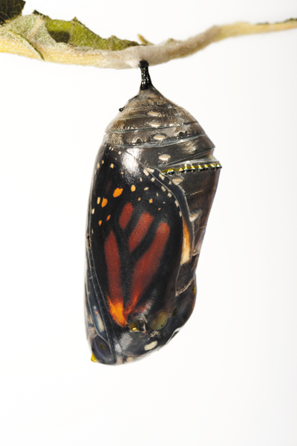
“All that’s needed is the desire to be heard. The will to learn. And the ability to see.”
- Scott McCloud, Understanding Comics
Notes:
Brandon
Keeping Architecture Relevant is, at it’s core, about Communication. To borrow a phrase from the Agile manifesto, it’s about individuals and interactions… over processes and tools

Slide 25

Questions

Slide 26

Thank You…
Brandon Satrom
Paul Rayner
bsatrom@gmail.com
www.userinexperience.com
paul@virtual-genius.com
www.virtual-genius.com
See our article in the March edition…
www.architecturejournal.net

Slide 27
References
Fonts:
Euphemia, Leelawadee
BoBsFrAnTiC True Type http://www.searchfreefonts.com/free/bobsfrantic.htm
BigMisterC : http://www.urbanfonts.com/fonts/BigMisterC.htm
Butterfly metamorphasis: http://www.ninibambini.com/pics/Metamorphasis.jpg
Garlic emerging: http://tinyfarmblog.com/tag/oats
Sticky Note: http://www.istockphoto.com/file_closeup.php?id=5602918
Domain-Driven Design book cover: http://domaindrivendesign.org/books/about_the_cover
Russian dolls: http://janti2008.wordpress.com/2009/04/22/nesting-with-the-dolls
Understanding Comics: http://www.harpercollins.com/book/index.aspx?isbn=9780060976255
Ruby on Rails: http://rubyonrails.org
Grady Booch: http://domino.research.ibm.com/library/cyberdig.nsf/papers/964EFC48D32D5B2D852576A9004F5289/$File/rc24924.pdf
Butterfly chryslis: http://animals.howstuffworks.com/insects/butterfly4.htm
Surfing baby: http://www.dailystoke.com/surfing-pop-culture/rip-surf-guide-magazine-satirical-fables-and-surfing-babies
S#arp ARchitecture: http://www.sharparchitecture.net
Cucumber: http://wiki.github.com/aslakhellesoy/cucumber
UML class diagram: http://yuml.me/diagram/scruffy/class/samples
UML sequence diagram: http://www.websequencediagrams.com
Astronaut: http://www.flickr.com/photos/nasa_hsf/3874968663/in/photostream/

